Slide 1
GCSE Sociology
The Sociological approach
Name ______________________

Slide 2
Course overview
Overview of the course
• This is a 2-year course.
• There is NO coursework, it is 100% exam based.
• You will sit 2 exams at the end of year 11. Both papers are 1 hour and 45 minutes long. They include 4 extended writing questions (12 marks each) plus shorter answer questions.
Topics:
Sociological theory (paper 1 and 2)
Research methods (paper 1 and 2)
Sociology of families (paper 1)
Sociology of education (paper 1)
Sociology of crime and deviance (paper 2)
Sociology of social stratification (paper 2)

Slide 3
Overview of booklet.
Print and Write Answers
• Please try to print this booklet and write your answers in it.
• Aim for approximately 20 double-sided pages.
Start Work for September on Page 6
• Prior to this, you’ll find information from the specification about the course and a very important checklist.
• Use the checklist to review your learning after completing the booklet.
Purpose of the Booklet
• The booklet is designed to set the foundation for the rest of the course.
• Sociology may be new to many of you, and the course demands mean we have limited free time throughout the year.
Mandatory and Necessary
• This booklet is both mandatory and necessary to understand the content we will explore in September.
• Bring this booklet during your first week to ensure it is completed by the end of that week.
• This allows you to ask any final questions about the content.
Research and Develop Skills
• You will need to research all relevant topics that come up in the booklet.
• The skills developed here will greatly assist you throughout the course.
Utilize Resources
• Remember, Google and YouTube are your friends!

Slide 4
Specification

Slide 5
Checklist

Slide 6
Introduction to sociological themes
Do now- Complete the spider diagram below.
What do you think sociology is about and why do we need to study it?
What is sociology and why do we need it?
Summary statement
_____________________________________________________________________________________________________________________________________________________________________

Slide 7
Introduction to sociological themes
Social structures
The structures that govern / organise our society
Can you think of any examples?
-
-
-
Social processes
Social processes are various ways in which human beings are affected by their interactions with others.
For example, a human baby does not know the norms and values of the society in which it has been born into. It has to be taught this. Whereas with animals, lots of their ways to live is as a result of instinct, we refer to this as nature vs nurture.
Being taught norms and values in the home is known as primary socialisation,
whereas the way we learn outside of the home through school for example is
secondary socialisation.
Social issue
A social issue is an issue that is of concern to members of a society. As individuals/groups look for solutions and become involved in these concerns, they become social issues.
Can you think of any social issues currently in society?
____________________________________________________________________________________________________________________________________________________________________________________________________________________________________
Challenge: Choose 1, who might be involved in this issue?
____________________________________________________________________________________________________________________________________________________________________________________________________________________________________

Slide 8
Introduction to sociological themes
Answer the following question in your exercise book.
Remember to copy the question before writing your answer.
Identify and describe one possible use of sociological research (3 marks)
How to answer a describe question…
What- What is a possible use?
Example- Give an example
Develop- Take it further, link it back to the question
What have you learnt about:
1. How to answer 3 mark questions? _________________________________________________________
__________________________________________________________________________________________________________________
2. What you would need to include in your answer? ____________________________________________________________________________________________________________________________________________________________________________________________________________________________________

Slide 9
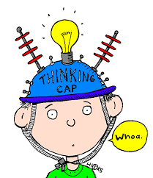
Norms, values and culture
Do now- What do you think the following might mean…
Norm-
Value-
Culture-
Define NORMS _____________________________________________________________________________________________________________________________________________________________________________________________________________________________________________________________________________________________
An example of a norm is: ___________________________________________________________________________________________________________________________________________________________________________
Challenge:
Think about the following social settings:
a cinema, an aeroplane, a GP’s waiting room.
1. Choose one setting and identify 2 norms related to this setting.
(UNDERLINE OR HIGHLIGHT ABOVE)
2. Identify 2 sanctions that might be applied to people who deviate from the norms in this setting.
____________________________________________________________________________________________________________________________________________________________________________________________________________________________________________________________________
3. How are norms enforced?
____________________________________________________________________________________________________________________________________________________________________________________________________________________________________________________________________

Slide 10
Norms, values and culture
Define VALUE _____________________________________________________________________________________________________________________________________________________________________________________________________________________________________________________________________________________________
An example of a value is: ___________________________________________________________________________________________________________________________________________________________________________
Some other values in contemporary British society include:
Value | Rank
Acquiring more and more consumer goods
Honesty and truth
Respect for life
Respect for elders
Privacy
Educational success
Achieving what you want no matter what the price
Reason for highest value (Ranked 1) ____________________________________________________________________________________________________________________________________________________________________________________________________________________________________
Reason for lowest value (Ranked 7) ____________________________________________________________________________________________________________________________________________________________________________________________________________________________________

Slide 11
Norms, values and culture
Quick recap…
Values provide us with general guidelines for conduct but norms are specific to social situations.
So… In the UK we value our privacy and believe that your personal information should be confidential so it is a norm not to read other people’s emails/texts without permission.
Define CULTURE _____________________________________________________________________________________________________________________________________________________________________________________________________________________________________________________________________________________________
How is British culture different to another world culture?
_____________________________________________________________________________________________________________________________________________________________________________________________________________________________________________________________________________________________
Can you think of any ways that British culture has changed in the last 50 years? _____________________________________________________________________________________________________________________________________________________________________________________________________________________________________________________________________________________________

Slide 12
Norms, values and culture
But how do we learn these norms and values within our culture.
Around the image below, write down all the ways we might be learning about the norms and values of society
So how do you think are the agents of social control within society (institutions that influence/control our behaviour)?
Challenge: Which are formal (where our behaviour is controlled through organisations in society) and which are informal (the way we are controlled through those that socialise us)
________________________________________________________________________________________________________________________________________________________________________________________________________________________________________________________________________________________________________________________________________________________________________________________________________________________________________________________________________

Slide 13
Norms, values and culture
Summary in action
A new international student is going to join Year 10 at our school.
Create a list of top tips to help them fit in.
Include some norms and values that they’ll need to know in order to fit into our culture.

Slide 14
Socialisation
Stick your socialisation homework here

Slide 15
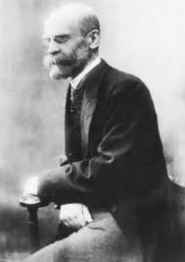
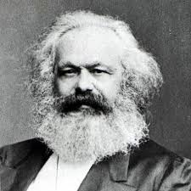
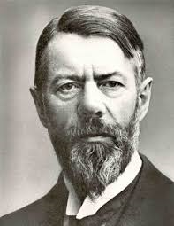
Founding fathers of Sociology
Do now- Recap
What is meant by the following…
Norm:
Value:
Culture:
Bonjour, je m’appelle Emile Durkheim
Guten Tag, Ich heiBe Karl Marx
Guten Tag, Ich heiBe Max Weber

Slide 16
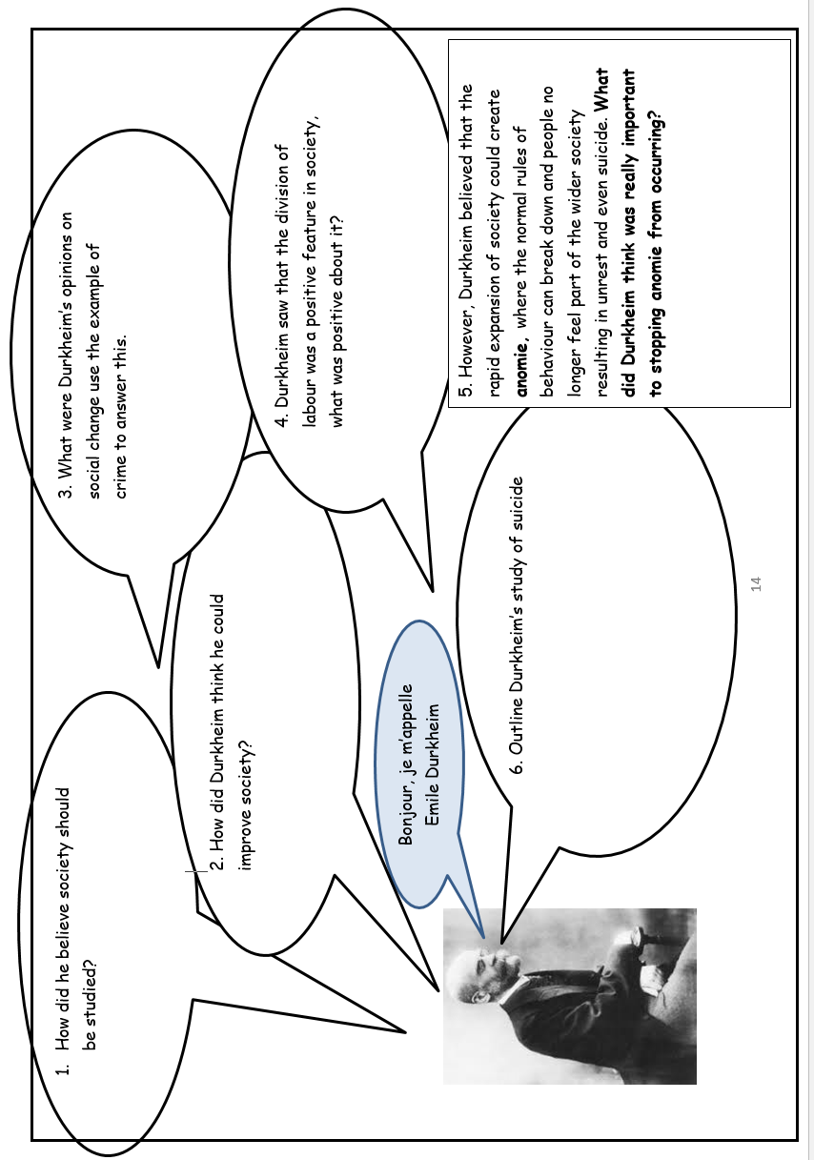

Slide 19
Founding fathers of Sociology
Summary recap quiz
1) Did Durkheim see the division of labour as a positive or negative feature of society? Explain your answer
_____________________________________________________________________________________________________________________________________________________________________________________________________________________________________________________________________________________________
2) Why did Marx see industrial capitalism as a bad thing? Explain your answer
_____________________________________________________________________________________________________________________________________________________________________________________________________________________________________________________________________________________________
3) Weber disagrees with Marx about the starting point of capitalism. How does Weber believe Capitalism emerged?
_____________________________________________________________________________________________________________________________________________________________________________________________________________________________________________________________________________________________
Challenge: Can you offer any criticisms of the theories we have looked at today?
_____________________________________________________________________________________________________________________________________________________________________________________________________________________________________________________________________________________________ ___________________________________________________________________________________________________________________________________________________________________________

Slide 20
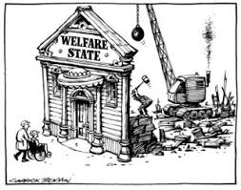
Theories in Sociology
Do now- Look at the theories we are going to be looking at below. Do you have any previous knowledge about what you think their ideas may be about society?
Theories about society… These are the main questions that all sociologists aim to answer.
There are grand (big theories) that provide sociologists with a broad framework on how to answer these questions.
Some of these theories are less fashionable than they once were yet they are still all very important. These big theories don’t only tell us about the history and the development of sociology but they also give us insights into the social world today…
Functionalism
New Right
Marxism
Interactionism
Feminism

Slide 21
Theories in Sociology
Functionalism
A theory developed by Durkheim that describes society as being in a state of balance or agreement (consensus). Each aspect of society serves a function that helps maintain society as a whole but also acting as a ‘social glue’ that keeps people together as a group.
Without this social glue, people feel they are disconnected from wider society and experience anomie. Functionalist sociologists are interested in studying the ways in which different aspects of society function to maintain consensus and prevent anomie (a breakdown of norms).
Explain functionalism using diagrams, pictures and no more than 8 words?
Challenge: Do you think Functionalism is a conflict theory (there is inequality) or a consensus theory (an agreement)? (Explain)

Slide 22
Theories in Sociology
Marxism
Watch and summarise the key concepts. (https://www.youtube.com/watch?v=W0GFSUu5UzA)
Challenge: Do you think Marxism is a conflict theory (there is inequality) or a consensus theory (an agreement)? (Explain)

Slide 23
Theories in Sociology
Feminism
A theory developed by many different people, mostly women, which describes society as an unequal relationship between men and women that keeps them in a state of conflict.
The whole of society is organised in ways that keep power in the hands of men (even though not all men may benefit from this power, or it may even be harmful to men). This system is called the patriarchy. Feminist sociologists are interested in exposing and studying this system of power and exploitation and showing how it affects women.
Can you explain feminism using diagrams, pictures and no more than 8 words?
Challenge: Do you think Feminism is a conflict theory (there is inequality) or a consensus theory (an agreement)? (Explain)

Slide 24
Theories in Sociology
Interactionism
A micro theory developed by a number of sociologists that focuses not on looking at society as a whole but instead looks at how people interpret the world around them and interact with each other. Our lives are made up of social interactions that communicate what we mean to other people and try to make sense of what they are meaning.
Interactionism sociologists are interested in studying how people communicate with and interact with each other to share ideas of culture, norms and values.
Bullet point interactionism into 3 bullet points
1)
2)
3)
Challenge: Interactionists are interested in labelling and how labelling someone can influence the way they behave (self fulfilling prophecy). Can you give an example of how this might happen?

Slide 25
Theories in Sociology
New Right
The New Right, in many ways, shares the views of functionalists with the main difference being that they argue that, in the late 20th century in countries like the UK and the USA, society became dysfunctional. The New Right argument is that a range of government policies, most notably those associated with the welfare state, undermined the key institutions in society and caused issues.
New Right ideas were instrumental in changing modern conservatism in the 1970s and were highly influential on both Margaret Thatcher and Ronald Reagan. It would be possible to argue that the New Right is a political movement rather than a sociological theory; its observations on those groups in society with very different and conflicting norms and values can lead some to question whether it is a consensus theory. However, the New Right support a society like that envisaged by functionalists and support government policies which to try and change society in that way (such as tax breaks to encourage traditional nuclear families).
How you summarise this is up to you…
Challenge: New Right have similarities to functionalism, do you know what these might be?

Slide 26
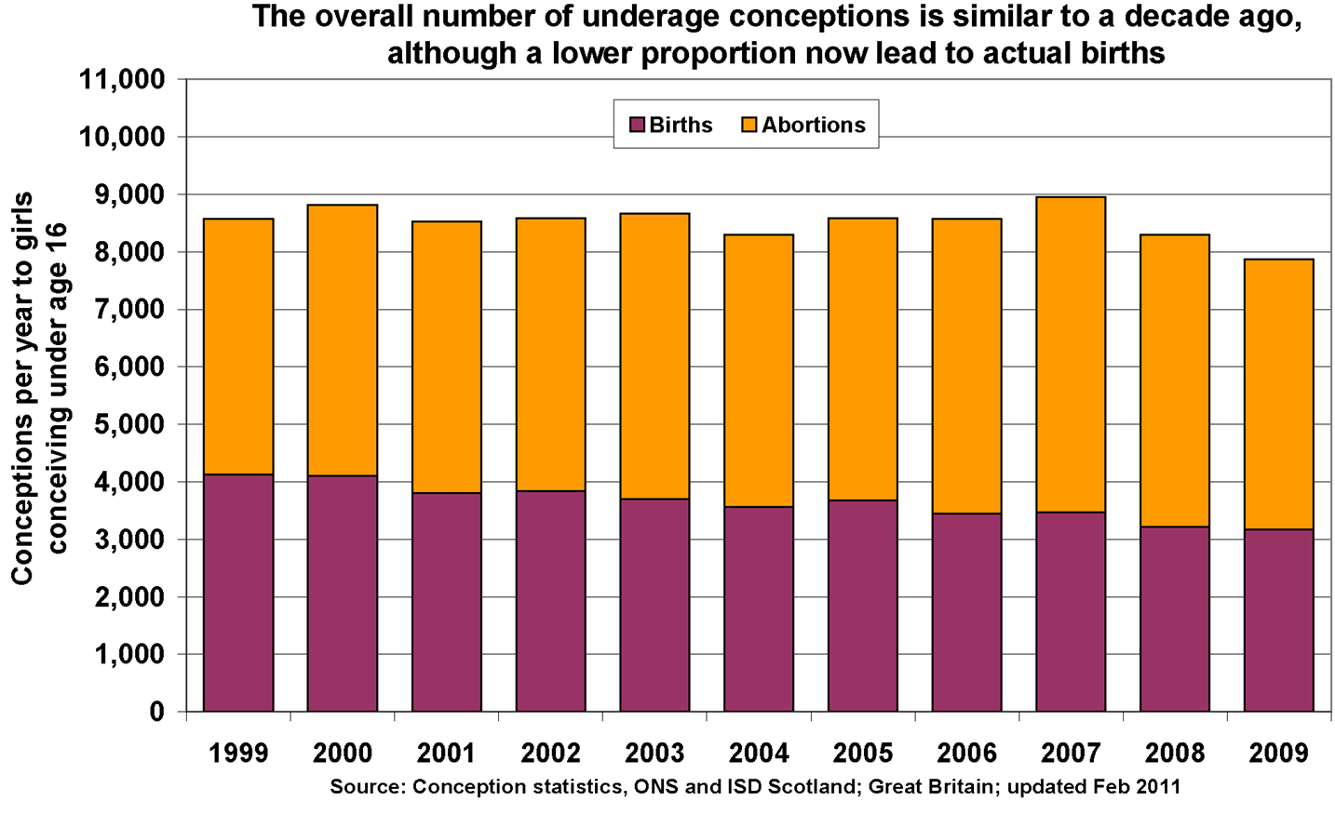
Research data
Do now
What does this graph tell us? ____________________________________________________________________________________________________________________________________________________________________________________________________________________________________
What doesn’t this information tell us? ____________________________________________________________________________________________________________________________________________________________________________________________________________________________________
How might we find out about the things it does tell us? ____________________________________________________________________________________________________________________________________________________________________________________________________________________________________

Slide 27
Research data
Qualitative and Quantitative Research
Qualitative research - Collects information on what is really happening, it gives a valid picture. Information is collected from the researchers’ immediate experience of society. Data is descriptive (not statistical or numerical).
Quantitative research - Collects information based on numbers & statistical analysis. Data tells you how many people give particular answers/fall into particular categories.
Qualitative research examples | Quantitative research examples
Evaluation - Positives | Evaluation - Positives
Evaluation - Negatives | Evaluation - Negatives

Slide 28
Research data
Summary recap – Exit Ticket
1) List 3 research methods are commonly used by qualitative researchers?
___________________________________________________________________________________________________________________________________________________________________________
2) List 3 research methods are commonly used by quantitative researchers? ___________________________________________________________________________________________________________________________________________________________________________
Challenge: What do you think sociologists mean by mixed methods?
_____________________________________________________________________________________________________________________________________________________________________________________________________________________________________________________________________________________________

Slide 29
Culture and nature
Do now- Match up the key words and definitions
Challenge: Can you give an example of each?
Key word |  | Definition
Culture |  | To care for a child whilst it is growing up. It refers to environmental factors instead of biology.
Nature |  | The scientific idea that human behaviour has evolved. It is not only physical features that have evolved, behaviour has also evolved. Human behaviour is down to genetics.
Nurture |  | Refers to the natural state of the world before society started to transform it. It also focuses on the way in which biology can influence human behaviour.
Sociobiology |  | Describes the way of life of a society. It is it’s beliefs, ideas and practices of a particular society or group.
Key word | Examples
Culture
Nature
Nurture
Sociobiology

Slide 30
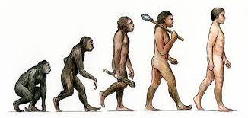
Culture and nature
There is a long standing argument over what influences the way we behave. Some think it’s due to nature, some think nurture, others think evolution (sociobiology).
There are cases where by children haven’t been socialised in the way expected and as such, this impacts on their behaviour (as you will see when you complete your homework on socialisation).
Sociologists believe that these cases can help us to answer what really causes us to behave the way we do.
Evidence for Nature Scan Scan | Evidence for Nurture Scan
Evidence for sociobiology
Using evidence, explain which you think has most influence over our behaviour.
____________________________________________________________________________________________________________________________________________________________________________________________________________________________________________________________________________________________________________________________________________________________
Notes:
https://www.youtube.com/watch?v=VjZolHCrC8E
https://www.youtube.com/watch?v=Rw_aVnlp0JY

Slide 31
Sex and Gender
Do Now
Create a new male or female classmate and then label the characters.
• Give them a nickname
• What toys/games they would have as a child?
• What films/books they would enjoy?
• What subjects they would choose at school?
• What is their favourite colour?
• Give them a career aspiration (be sensible – realistically there will not be many astronauts!)
Other key terms
STEM – Science, technology, engineering and mathematics.
Patriarchal – Male dominated society
Glass ceiling – An informal barrier that prevents women from achieving senior positions.
Socially organised labour – Human activity intended to satisfy the economic needs of society.

Slide 32
Sex and Gender
Define…In sociology…
…sex means… ________________________________________________________________________________________________________________________________________________________________________________________________________________________________________
…gender means… ________________________________________________________________________________________________________________________________________________________________________________________________________________________________________
Looking back to your class mate…
Does your person fit a stereotype of what a male / female is like? ____________________________________________________________________________________________________________________
How many people in our class designed a stereotypical class mate? ____________________________________________________________________________________________________________________
What do you think influences our beliefs about the behaviour of males and females?
_______________________________________________________________________________________________________________________________________________________________________________________________________________________________________________________________________________________________________________________________________________________________________________________________________________________________________________________________________________________________________________________________

Slide 33
Sex and Gender
Today gender stereotypes are being broken down and girls are encouraged as much as boys to study STEM subjects, excel at school and are encouraged to have high career aspirations. Women enter into politics and take up roles as CEO’s in large corporations, breaking the glass ceiling that once existed. Although there are laws to ensure equality occurs, this is not always the case when we look at contemporary British society. Recently the BBC has been highlighted as paying women less than their male counterparts for doing the same job and it has been found that fewer women have been offered the ‘top’ jobs within the organisation.
Societies and cultures make assumptions about what men and women should do, some believe that men should be tough and provide for their family whilst women stay at home and look after their family. Some people put this down to biology! This has not always been the case though and does not exist in all societies.
So… going back to the question, what makes a boy a boy and a girl a girl. Let’s imagine a scenario.
Identical twins are born and both boys are happy and healthy. However, a serious accident happens soon after birth and one of the boys needs to have their genitals reconstructed as if they were female. The children as raised from babies as brother and sister.
Do you think that nurture would enable the child accept the gender that they were given very soon after their birth? ______________________________________________________________________________________________________________________________________________________________________________________________________________________________________________________________________________________________________________________________________________________________________________________________________
Additional knowledge… (Is nature or nurture the strongest?)
__________________________________________________________________________________________________________________________________________________________________________________________________________________________________________________________________________________________________________________________________________________

Slide 34
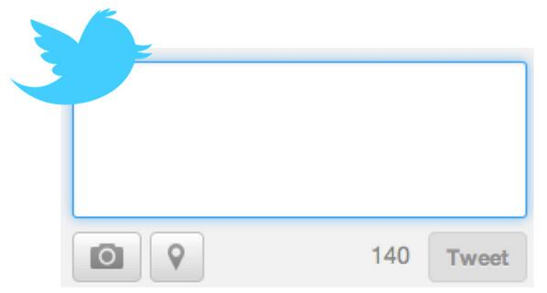
Sex and Gender
The Feminist Perspective
Why should biology be used to justify social differences in the treatment of men and women?
Males hormones are blamed on the reason why males are aggressive and assumed to be more assertive. Female hormones are seen as making women more gentle and nurturing, and don’t get me started on the reason why it is down to biology as to why women should feed / nurture their children!
Radical feminists argue that biological differences distract from the importance of making social and political changes to improve the status of women. In the past, many male sociologists (many functionalists) have accepted that there is a ‘natural’ role for women to be mothers and wives, Feminists such as Butler has challenged the patriarchal nature of gender roles and argue that these are constructed by society as a form of socially organised labour.
Tweet… in no more than 50 words, the Radical Feminist belief about gender

Slide 35
SCAN
Notes:
https://www.youtube.com/watch?v=3PyQS94Pfa8

Slide 36
Race and ethnicity

Slide 37
Race and ethnicity
Sociology in Action
Find a historical or contemporary (recent) example of racial prejudice and/or discrimination. Look in newspapers to help you with this.
Challenge: Can you explain the existence of displacement and/or scapegoating in your example.
________________________________________________________________________________________________________________________________________________________________________________________________________________________________________ ________________________________________________________________________________________________________________________________________________________________________________________________________________________________________ ________________________________________________________________________________________________________________________________________________________________________________________________________________________________________ ________________________________________________________________________________________________________________________________________________________________________________________________________________________________________ ________________________________________________________________________________________________________________________________________________________________________________________________________________________________________ ________________________________________________________________________________________________________________________________________________________________________________________________________________________________________ ________________________________________________________________________________________________________________________________________________________________________________________________________________________________________ ________________________________________________________________________________________________________________________________________________________________________________________________________________________________________

Slide 38
Facts and values
Do Now
List of 5 facts you believe to be true about the education system
_______________________________________________________
Evidence_______________________________________________________________________________________________________________________________________________________________________
2. _______________________________________________________
Evidence_______________________________________________________________________________________________________________________________________________________________________
3. _______________________________________________________
Evidence_______________________________________________________________________________________________________________________________________________________________________
4. _______________________________________________________
Evidence_______________________________________________________________________________________________________________________________________________________________________
5. _______________________________________________________
Evidence_______________________________________________________________________________________________________________________________________________________________________

Slide 39
Facts and values
What is a sociological fact?
In sociology, there is a long tradition of objectivity. _________________ is the attempt to present a picture of the world as it is and not how the researcher would like it to be.
________________ argued that sociologists should keep ___________________ (knowledge gained through scientific observation) separate from values. Weber wasn’t saying that sociologists should not have values; he was simply saying that we should not let them _________________ with sociological facts.
What are values?
A value is an _______________held by individuals and social groups. These differ from opinions because they have a ___________________ aspect to them, for example the importance of marriage and human rights.
Some ______________say there is no such thing as ‘value-neutral facts’ when it comes to the study of human behaviour and wonder if it is ever possible to have __________________ about the world.
Summarise what you have learnt this lesson in now more than 30 words

